Slide 1
Why this talk? - Story
Legacy system ; some pain points which made it hard to migrate
How could we simplify our future live?
Made us look into an appropriate approach for our context
Little experience DDD concepts and practices
New joiners inbound
Familiar with Java, switching Kotlin

Slide 2
What we’re we looking for
A ‘compass’ / guidelines to guide new development into the pit of success?
A focus on the application (problem) domain
Easily testable
Flexible in the face of change

Slide 3
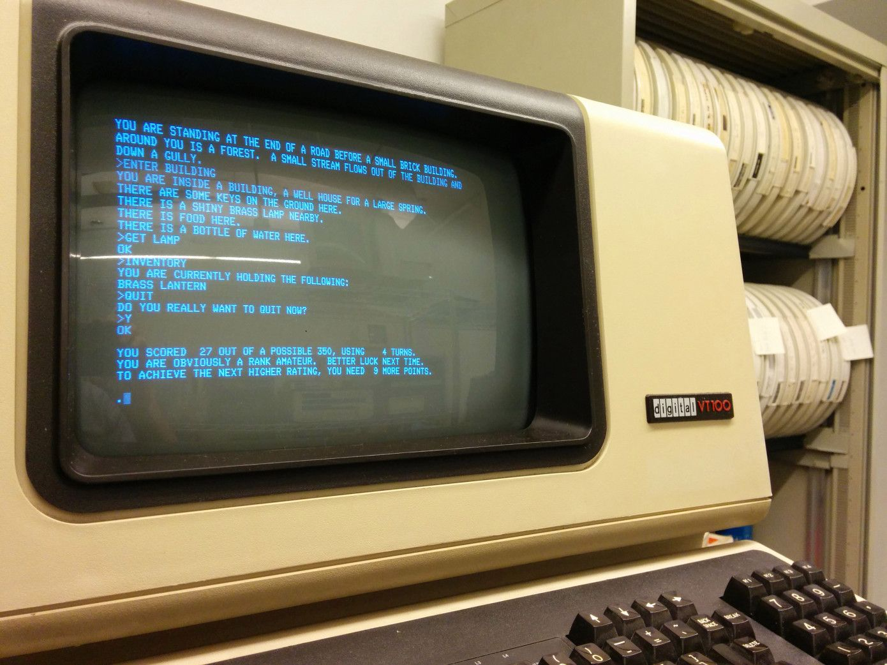



LEGACY TO EDA
B I Z
ORACLE
Notes:
Legacy system in need of migration
Recent assignment
Large business critical system, millions messages a day
Effectively a pipeline ; chain of java services with oracle involved
This system had N teams, my team one of them
Legacy system ; pain points which made it hard to migrate
Team moving legacy system to eda system
Migration challenges
Business domain logic not easily found [sherlock]
Spread out across different layers ; invariants / logic (controller, service, data, db constraints), technically tangled [tapes]
Busines concepts implicit (4 boolean flags to represent different offer types) [screen]
Test scope (business logic sometimes only proven with broad level test) [caliper]
OPEX questions (time to trace business understanding and provide answers) [operational wheels]
Team understanding

Slide 4


biz logic spread
unexpressed domain concepts
TEAM
diverse understanding
tech tangled biz
Notes:
Team challenges with our application services
Spread biz logic ; sproc, web, service, dal ; decision paths (policy), conditionals, invariants
Implicit business concepts
Made us look into an appropriate approach for our context
Little experience DDD concepts and practices
New joiners inbound
Familiar with Java, switching Kotlin

Slide 5

YOUR FUTURE?
Notes:
Why am I telling you all of this?
THE TEAM WAS AT A CROSSROADS
MAYBE YOU HAVE SIMILAR QUESTIONS:
Did we manage / how did we put your application business domain front and center? (conceptually)
YOUR CONTEXT - In an approachable way (little, no experience with ddd concepts and practices)
What does it look like? Concretely
What approach is appropriate for our context
At team level, little to no experience DDD concepts (evans) and practices
New joiners inbound
Familiar with Java, switching Kotlin
Simplify our future?
Where we want to be:
Techno:
Codebase: feel at home ; know where to look for domain
---
A ‘compass’ / guidelines to guide new development into the pit of success?
A focus on the application (problem) domain
Easily testable
Flexible in the face of change

Slide 6

ONE MIGHT WONDER
did you put
domain front & center?
what it look like?
other
or similar experiences?
how did it pan out?
Notes:
Why am I telling you all of this?
THE TEAM WAS AT A CROSSROADS
Maybe you are too
What approach is appropriate for our context
At team level, little to no experience DDD concepts (evans) and practices
New joiners inbound
Familiar with Java, switching Kotlin
Where we want to be:
Techno:
Codebase: feel at home ; know where to look for domain
---
A ‘compass’ / guidelines to guide new development into the pit of success?
A focus on the application (problem) domain
Easily testable
Flexible in the face of change

Slide 7
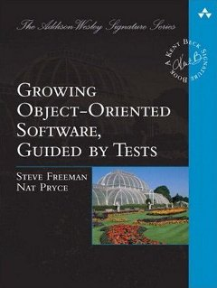
THAT BOOK

Slide 8
Ports and adapter concepts
Boundary around application domain
Higher level of abstraction
Separate business from technical concerns (what from how)
Ports
Facilitates interaction with domain from the outside
About: What
Concrete: interfaces defined by the domain
Adapters
Bridge technical –to application domain
About: How
Concrete: implementations of domain ports

Slide 9
PORTS & ADAPTERS
an application domain model is mapped onto technical infrastructure
D
T
source: GOOS
Notes:
Boundary around application domain
Higher level of abstraction
Separate business from technical concerns (what from how)

Slide 10
Port
“Interface that describes the relationship between the application domain
and its outside world,
in its [app domain] terminology”
Facilitates interaction with domain from the outside
About: What
Concrete: interfaces defined by the domain
Notes:
Conceptual interface
Can be
a domain façade interface or
a set of more narrow use case interfaces
a set of command / query messages
A distinction can be made between Inbound (driving) port

Slide 11
PORTS
facilitate interaction between application –and technical domain *
D
T
source: GOOS
Notes:
Facilitates interaction with domain from the outside
About: What
Concrete: interfaces defined by the domain

Slide 12
Adapter
“Allows interaction through particular port using particular technology, bridging application –and technical domains”
Bridge technical –to application domain
About: How
Concrete: implementations of domain ports

Slide 13
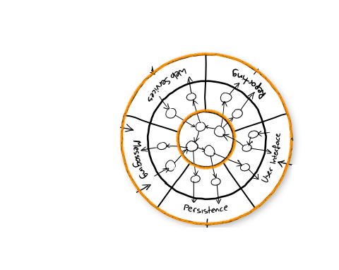




ADAPTERS
adapts external stimuli into application domain and vice versa
D
T
source: GOOS

Slide 14
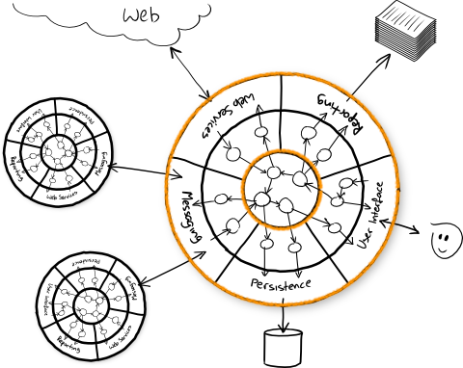




PORTS & ADAPTERS
imagine a system as a network of these adapted domains
source: GOOS

Slide 15
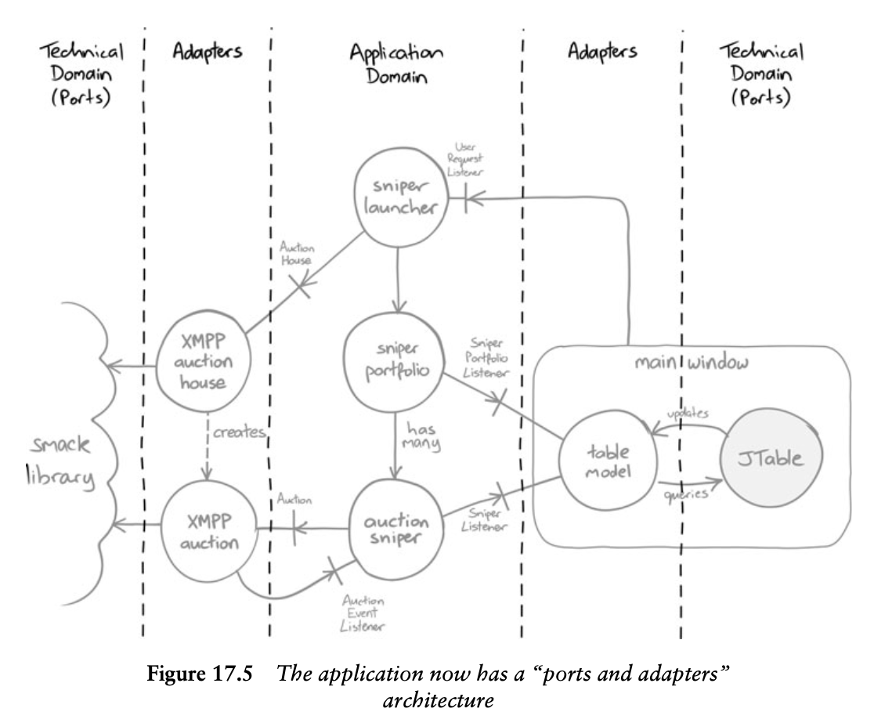
PORTS & ADAPTERS
source: GOOS

Slide 16
How applied: development
Walking skeleton: end to end test (pubsub, given in context)
Make layers explicit: DomainApi (fake but working impl no ports)
Forced external api and primary domain port into existence
Increment on full functional test slices
End to end test
Adapter integration test
Functional test

Slide 17

PORTS & ADAPTERS
APPLIED
Notes:
Codebase layout
Architecture evident packaging
Domain stands out
Ports & adapters layer = package
Adapters partitioned by ‘integration domain’
Persistence ignorant
Optimistic locking – Exceptions propagate to caller
Tx demarcation as technical ‘composition’ concern
Testing
Functional (domain) tests
Extensive testing of domain logic behavior / invariants
Adapter integration tests
Send message over protocol, proof domain activated as expected
This covers external –to domain message format conversion
End to end tests
‘Fakes’ to represent external dependencies
Proves application service components are properly wired and functional
Implementation alternatives

Slide 18
How applied: codebase
Architecture evident packaging
Ports & adapters layer = package
Adapters partitioned by ‘integration domain’
Persistence ignorant
Optimistic locking – Exceptions propagate to caller
Tx demarcation as technical ‘composition’ concern

Slide 19
How applied: testing
Stereotype tests
Functional (domain) tests
Extensive testing of domain logic behavior / invariants
Adapter integration tests
Send message over protocol, proof domain activated as expected
This covers external –to domain message format conversion
End to end tests
‘Fakes’ to represent external dependencies
Proves application service components are properly wired and functional

Slide 20
Implementation alternatives
Domain primary port(s)
Dynamic dispatch to use case handler (query, command, event)
Segregate command from query
Model domain in DDD aggregate fashion

Slide 21

OBSERVATIONS
more model mapping
indirection
align your terminology
really ’trivial’ projects may not warrant
Notes:
domain focus
Capture business intent
Isolate business invariants
Capture understanding
Architecturally evident codebase
Maintainability ; FEELING AT HOME
Application use cases
Invariants and constraints
Messages sent and received
Patterns

Slide 22
Perceived benefits architectural approach
Relatively simple to onboard (both approach & code)
Highlights application problem domain
Modular, testable (also usual suspects)
Team alignment on high over architectural philosophy
Team has high confidence in application service
Enables different options regarding work division
Enables architecture violation checking *
Notes:
* Depending on

Slide 23

OBSERVATIONS
domain focus
highlights problem domain through higher level abstractions
enhanced testability
technicalities be technicalities
enhanced modularity
development approach options
architecturally evident codebase
enables verifiable architecture
Notes:
domain focus
Capture business intent
Isolate business invariants
Capture understanding
Architecturally evident codebase
Maintainability ; FEELING AT HOME
Application use cases
Invariants and constraints
Messages sent and received
Patterns

Slide 24


increased agility
shared
domain perspective
increased
team
confidence
shared architecture philosophy
Notes:
domain focus
Capture business intent
Isolate business invariants
Capture understanding
Architecturally evident codebase
Maintainability ; FEELING AT HOME
Application use cases
Invariants and constraints
Messages sent and received
Patterns

Slide 25
We’re the sum of all our experiences
Tom thibodeau
Notes:
Why am I telling you all of this?
THE TEAM WAS AT A CROSSROADS

Slide 26
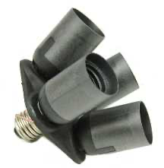
Ports & adapters
aka hexagonal
Notes:
Why this talk?
Applied ports and adapters in recent gig
Team found it useful
Share experiences

Slide 27
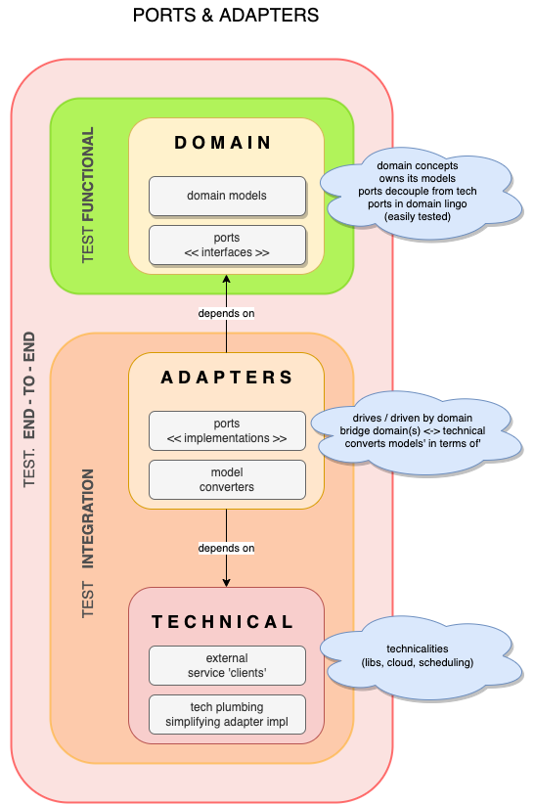

Slide 28
“An architectural pattern where
business domain code is isolated
from its dependencies
on technical infrastructure”

